Slide 1
Bare International Analysis
Presented by: Priyanka T S
Batch No : CX EVG-129
Project : 3 Topic :Bare International Analysis
Evaluation of Style Advisor Performance

Slide 2

Project Overview
This project entails evaluating the
performance of Style Advisors by
analyzing their evaluations based
on specific criteria, including store
ambiance, first impressions, and
overall experience. The goal is to
understand how effectively Style
Advisors engage with customers
and maintain store standards for
maximizing customer satisfaction.

Slide 3
Objectives of Analysis
The primary objectives include assessing the overall performance of Style Advisors, identifying high and low performers, and understanding factors impacting customer experience. Insights will lead to targeted training and performance enhancement strategies for optimal service delivery.

Slide 4
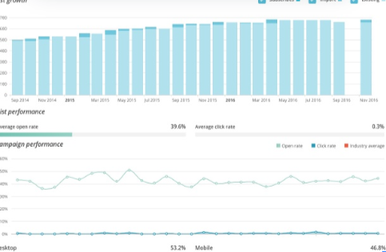
Columns Explanation
The dataset contains key columns such
as Evaluation_ID, Evaluation_Date,
Evaluation_Score, and various
performance metrics like STORE
AMBIANCE and RECOMMENDATIONS.
These columns help in assessing
the overall performance of Style
Advisors and understanding
customer experiences better.

Slide 5
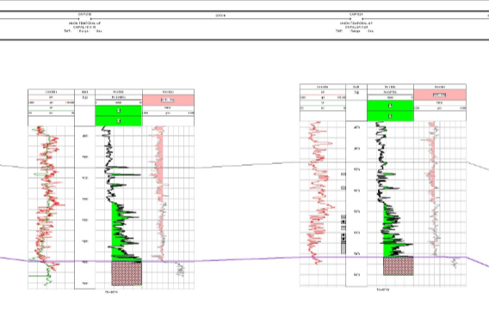
Data Structure
The data is structured in rows
representing individual evaluations,
with associated scores across
multiple criteria. Each evaluation
captures specific aspects of the
customer experience in the store,
creating a comprehensive view
of performance across different
zones and periods.

Slide 6

Performance Grading Scale
Performance is graded on a scale
categorized as High Performer,
Average Performer, and Low
Performer based on Evaluation Scores.
This grading allows for clear
differentiation of performance
levels among Style Advisors,
facilitating targeted improvements.

Slide 7
1.Performance Grading
Zone | Average performer | bottom performer | High Performer | Low performer | Grand Total
East | 14% | 14% | 29% | 43% | 100%
North | 47% | 5% | 21% | 26% | 100%
South | 39% | 17% | 11% | 33% | 100%
West | 59% | 18% | 12% | 12% | 100%
Grand Total | 44% | 13% | 16% | 26% | 100%

Slide 8

Grading Assignment Example
For instance, a Style Advisor
with an Evaluation_Score of 90
is classified as a High Performer,
while those with scores below 50
are categorized as Low Performers.
This classification aids in identifying
training needs and recognizing
high achievers within the team.

Slide 9
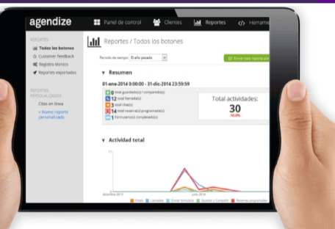
Pivot Table Insights
The pivot table analysis reveals
the average Evaluation_Score
segmented by Zone, highlighting
key strengths and weaknesses.
Notable observations show which regions
consistently outperform others,
providing a basis for targeted
management efforts.

Slide 10
2. Pivot Table Analysis The average Evaluation_Score by Zone:
Zone | Average of Evaluation_Score
East | 72
North | 77
South | 67
West | 72
Grand Total | 72

Slide 11
Trend of Evaluation Scores Over Time

Slide 12
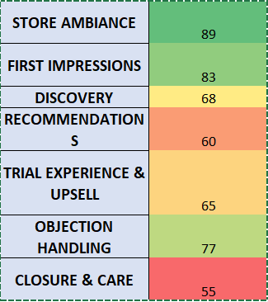
Performance Breakdown by Criteria

Slide 13
Percentage of High Performers by Region

Slide 14

High Performer Analysis
Analysis of high performers
indicates that certain regions,
like North Zone, have a significantly
higher percentage of high-scoring
evaluations. This correlation between
location and performance score
underscores the importance of
localized training and support initiatives.

Slide 15
Summary: for High Performance
1.Welcoming Store Ambiance
Clean, clutter-free stores with proper signage and lighting.
Most stores described as “WOW! Very appealing” by evaluators.
Well-organized layouts made product exploration easy.
2 Strong Greeting & First Impressions
Style Advisors greeted customers within 15 seconds with smiles and eye contact.
Customers were acknowledged quickly, typically within 2 minutes.
3 Effective Customer Discovery
Advisors asked personalized questions:
Profession
Brand/style preferences
Occasion or purpose of sunglasses
This helped tailor the experience to each customer.

Slide 16
4 .Brand Knowledge & Recommendations
Premium brands like Ray-Ban, Burberry, D&G, Prada frequently recommended.
Some advisors explained features, benefits, and brand stories.
Styling trays and microfiber cloths were used during product trials in high-performing stores.
5.Objection Handling
When customers raised price concerns, advisors offered:
Alternatives within the store
Discounts (e.g. “First pair discount”)
Additional details about quality and offers
6.Closure & Professionalism
Even when a sale didn’t happen, most advisors:
Maintained a polite tone
Thanked the customer
Invited them to return
Shared business cards or contact info

Slide 17
Top Performing Stores (Score 80%+)
City | Key Advisor | Score | Strengths
Amritsar | Neeraj | 88% | Excellent trial support, brand recommendation, clean store
Amritsar | Kamal | 84% | Multiple brands offered, clean and well-lit store
Jaipur | - | 84% | Great greeting, product trial and knowledge
Udaipur | - | 84% | Personalized approach, neat store, product recommendations

Slide 18
Low-to-Average Performing Stores (Below 75%)
City | Advisor | Score | Gaps Identified
Delhi | Ajeet | 60% | Skipped brand intro, no feedback, didn’t clean sunglasses
Delhi | Neeraj | 67% | Greeted well but didn’t upsell or handle objections properly
Ludhiana | Sunil | 76% | Didn’t handle objections or capture feedback post-trial
City | Advisor | Score | Gaps Identified

Slide 19
Gaps for Improvement
Inconsistent product trial hygiene (microfiber/tray often skipped)
Few advisors forgot to gather post-trial feedback
Missed upselling or explaining add-ons (e.g. cleaning kits, accessories)
Some stores lacked digital screens or did not highlight offers
Limited effort in objection handling or price justification

Slide 20
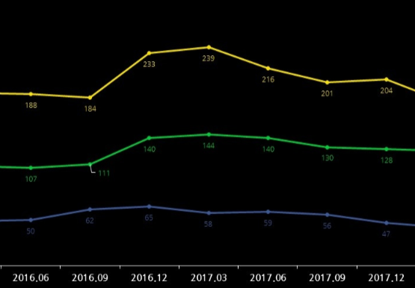
Visualizations Overview
Visualizations include bar charts
for average Evaluation Scores by
Zone and pie charts showing the
percentage of High Performers by
Region. These graphical
representations simplify complex
data and enable quicker insights
into performance trends.

Slide 21

Key Insights Summary
Key insights indicate fluctuating
trends in performance over time,
with some regions showing
consistent high scores. Understanding
these trends is essential for strategic
interventions and aligning training
efforts with regional needs.

Slide 22

Recommendations for Improvement
To enhance overall performance,
focus on training for Low Performers
identified in the analysis. Structured
workshops should be conducted in
underperforming regions to address
specific shortcomings, fostering a
culture of continuous improvement.

Slide 23

Recap of Findings
The analysis revealed varied
performance levels among
Style Advisors, with significant
discrepancies in evaluation
scores by region. Key insights
show that a focus on improving
training in critical areas like
customer engagement and
recommendations can
elevate overall performance
and customer satisfaction.

Slide 24
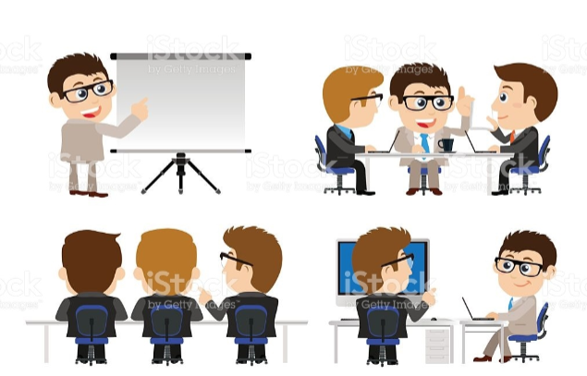
Steps to Improve
To improve Style Advisor effectiveness,
implement targeted training
programs addressing identified
weaknesses.
Follow-up evaluations
to assess the impact of these
interventions should be scheduled to ensure continuous improvement
and adaptation of strategies based
on performance feedback.

Slide 25
Thank you

